Slide 1
NBA Player Scoring Analysis
Maxwell Davis
BSAN 360-001
Due Date: March 20th, 2026
GitHub Repository: INSERT LINK HERE

Slide 2

Dataset Overview
Dataset: NBA Player Statistics
Source: Kaggle NBA Player Stats Dataset
https://www.nba.com/stats
Contains player performance metrics including games played, minutes, field goals, attempts, and points (Pretty straightforward).
Used to analyze scoring drivers in the NBA, and whether players with larger roles and confidence from coaches are more efficient.

Slide 3
Dataset Size & Key Variables
Observations: NBA players from 2023 season
Key variables:
• PTS – total points scored
• FGA – field goal attempts
• FG% – shooting efficiency
• GP – games played
• Min – minutes played
• Position grouping: BIG vs SMALL

Slide 4

Descriptive Statistics
Initial exploration checked ranges and missing values.
FG% ranges between 0 and 1.
Games played ranges between 0 and 82.
Points and attempts fall within realistic NBA performance ranges.
Missing values in critical variables were removed.

Slide 5
Research Questions
1. How strongly does shot volume (FGA) influence scoring?
2. Does shooting efficiency (FG%) significantly impact points scored?
3. Do BIG and SMALL players differ in scoring efficiency?
4. Are high-volume shooters more or less efficient than low-volume shooters?
5. Which variables best predict scoring output?

Slide 6

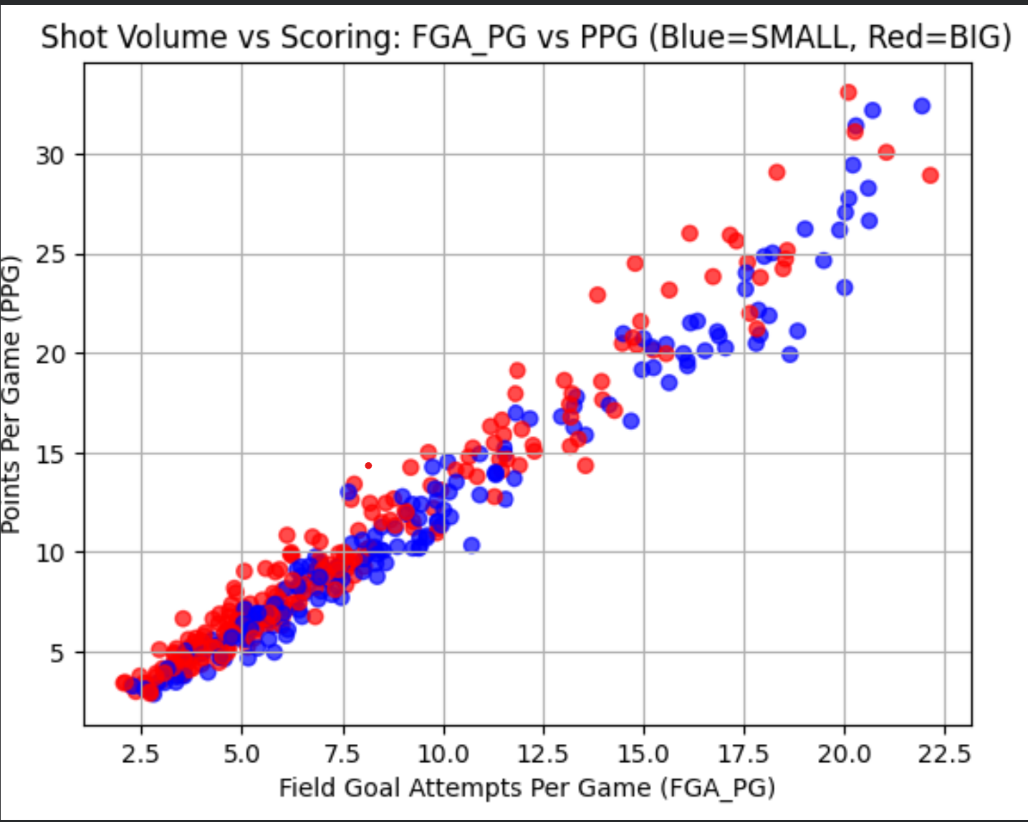
Shot Volume vs Scoring
Scatter analysis shows a strong relationship between field goal attempts and total points.
Players who take more shots generally score more points.
This suggests scoring is heavily driven by offensive opportunity.

Slide 7

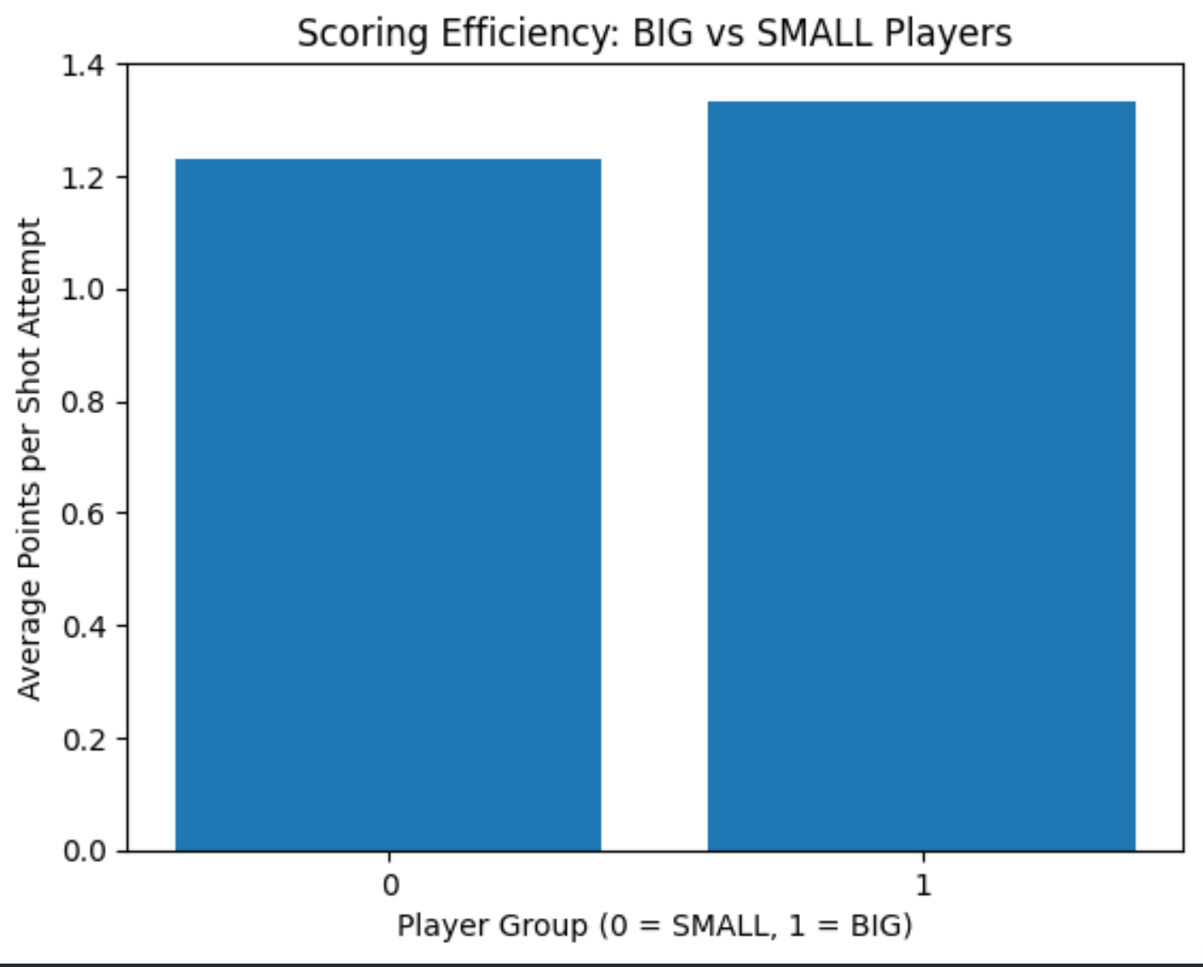
Efficiency Analysis
Created a new metric: Points per Shot Attempt.
This measures how efficiently players convert shot attempts into scoring.
BIG vs SMALL comparison shows positional differences in efficiency.

Slide 8
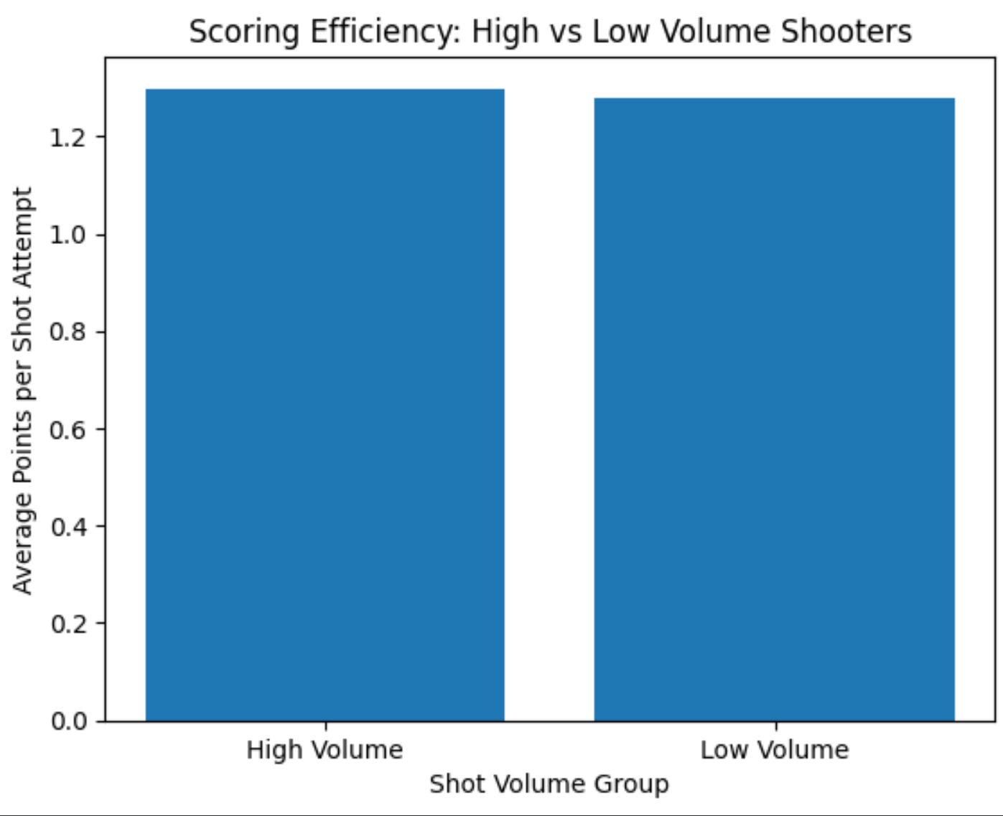
High vs Low Volume Shooters
Players were grouped based on shot attempt volume.
High-volume shooters score more overall points.
However, efficiency does not always increase with volume.

Slide 9
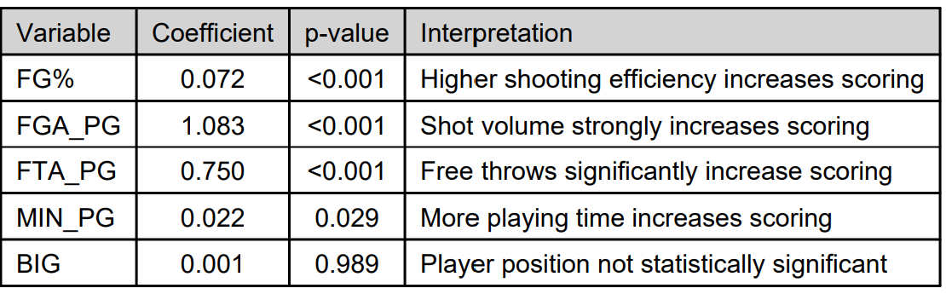
Regression Model Results
Regression model used PTS as the dependent variable.
Predictors included:
FGA
FG%
Free throw attempts
Minutes played
Shot attempts and playing time were strong predictors of scoring. R-squared was 0.989 indicating the model was a strong representation with a p value of less than .001 indicating statistical significance.

Slide 10
Key Insights
Shot volume is the strongest driver of scoring.
Efficiency matters but opportunity plays a larger role.
Different player positions show varying scoring patterns.
High-volume shooters dominate total scoring output.

Slide 11
Conclusion & Recommendations
NBA scoring is primarily driven by shot volume and playing time. Confidence and the “green light” can help drive higher scoring numbers, which is further proven by the next point which is high usage.
Teams seeking high scorers should prioritize players with high usage rates (Players spending more time with he ball in their hands).
Efficiency metrics help identify undervalued players who score effectively with fewer attempts. These players may not score as much but are effective when used and could likely cost less for teams to sign. These could be developing stars that do not yet dominate their teams but play well.

